Slide 1
CS-3002: Information Security
Week#2

Slide 2
Modern Ciphers
Modern ciphers
Sophisticated design using substitutions and permutations
Round-based encryption and decryption algorithms
Efficient implementations in hardware and software
Common classes of modern ciphers
Block ciphers = processing of fixed-length blocks
Examples: DES, AES, Blowfish
Stream ciphers = processing of individual bits or bytes
Examples: RC4, A5/1

Slide 3
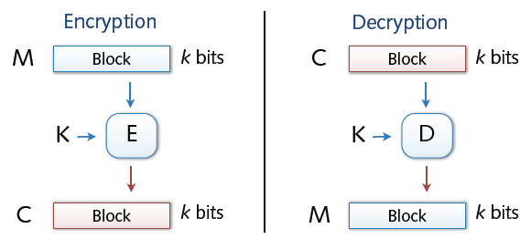
Block Cipher
Encryption and decryption in blocks (e.g., 64 or 128 bit)
Padding of short messages, splitting of long messages
Different modes of operations: ECB, CBC, CTR, ...
Examples:
DES: n= 64 bits, k = 56 bits
3DES: n= 64 bits, k = 168 bits
AES: n=128 bits, k = 128, 192, 256 bits

Slide 4
Block Ciphers Built by Iteration
key k
key expansion
k₁
k₂
k₃
k_{n}
m
R(k₁, ⋅)
R(k₂, ⋅)
R(k₃, ⋅)
R(k_{n}, ⋅)
c
R(k,m) is called a round function
for DES (n=16)
Notes:
Typically built on iterations

Slide 5
Design Characteristics for Block Ciphers
Choice of blocklength n
n too long → complex algorithm, performance loss
n too short → weak encryption, easy to attack
Modern variants use n = 128 - 256 bit
Choice of the key length of k
Practical key length: 80 - 256 bit
k too short → systematic testing of all valid keys (Brute Force attack)
Against Brute Force attacks, a minimum of 70-80 bit are necessary

Slide 6
Confusion and Diffusion (Recap)
What makes a cipher secure? Hard to tell
Confusion property
Complex relation between key and plaintext/ciphertext
✸ Hard to deduce key from plaintext/ciphertext pairs
Diffusion property
Complex relation between plaintext and ciphertext
✸ Hard to deduce bits of plaintext from ciphertext

Slide 7
Data Encryption Standard (DES)

Slide 8
The Data Encryption Standard (DES)
Early 1970s: Horst Feistel designs Lucifer at IBM
key-len = 128 bits ; block-len = 128 bits
1973: National Bureau of Standards (NBS) asks for block cipher proposals
IBM submits variant of Lucifer.
1976: NBS adopts DES as a federal standard
key-len = 56 bits ; block-len = 64 bits
Every 5 years:
DES review for decision about further usage
Result: Until now, no modifications were made

Slide 9
The Data Encryption Standard (DES)
Problem of DES:
Usage of a key with a length of 56 bit
Criticized for a key length too short for usage in practice
1997: DES broken by exhaustive search
2000: NIST adopts Rijndael as AES to replace DES

Slide 10
DES Challenge
1997: Internet search -- 3 months
1998: by distributed.net in 41 days in early 1998.
The plaintext was "The secret message is: Many hands make light work.“
1998: Electronic Frontier Foundation (EFF) machine (deep crack) -- 56 hours
The text was revealed to be "The secret message is: It's time for those 128-, 192-, and 256-bit keys.“
1999: combined search -- 22 hours
The plaintext was See you in Rome (second AES Conference, March 22-23, 1999)
⇒ 56-bit ciphers should not be used !! (128-bit key ⇒ 2⁷² days)

Slide 11
DES: core idea – Feistel Network
DES is based on Feistal Network
Consists of invertible function F: {0,1}^{2n} ⟶ {0,1}^{2n}
n-bits
R₀
R₁
R₂
R_{d-1}
R_{d}
f₁
f₂
⋯
f_{d}
L₀
L₁
L₂
L_{d-1}
L_{d}
n-bits
⊕
⊕
⊕
input
output
In symbols:

Slide 12
Inverse of Feistal Function
Feistel network F: {0,1}^{2n} ⟶ {0,1}^{2n} is invertible
R_{i-1}
R_{i}
R_{i-1} = L_{i}
L_{i-1} = f_{i}(L_{i}) ⨁ R_{i}
inverse
f_{i}
L_{i-1}
L_{i}
⊕
R_{i-1}
R_{i}
R_{i}
⊕
R_{i-1}
inverse
f_{i}
L_{i}
f_{i}
L_{i-1}
L_{i-1}
L_{i}
⊕

Slide 13
Decryption circuit
R_{d}
⊕
⊕
⊕
n-bits
R_{d-1}
R_{d-2}
R₁
R₀
⋯
f_{d}
f_{d-1}
f₁
L_{d}
L_{d-1}
L_{d-2}
L₁
L₀
n-bits
Decryption is basically the same Inverted circuit, with f₁, …, f_{d} applied in reverse order

Slide 14
Example
Discussed in Class

